Slide 1
Midterm Review
Graph basics: simple, directed, bipartite, multi, graphs.
Vertex, edge, degree, relation between number of degrees and edges
Isomorphism
Complete graph, complete bipartite graph
Total and sorted degree comparison
Bipartite or not
Compare complements
Subgraph comparison
Adjacency matching
Directed graph
Edge counting: the total number of degrees must be EVEN.

Slide 2
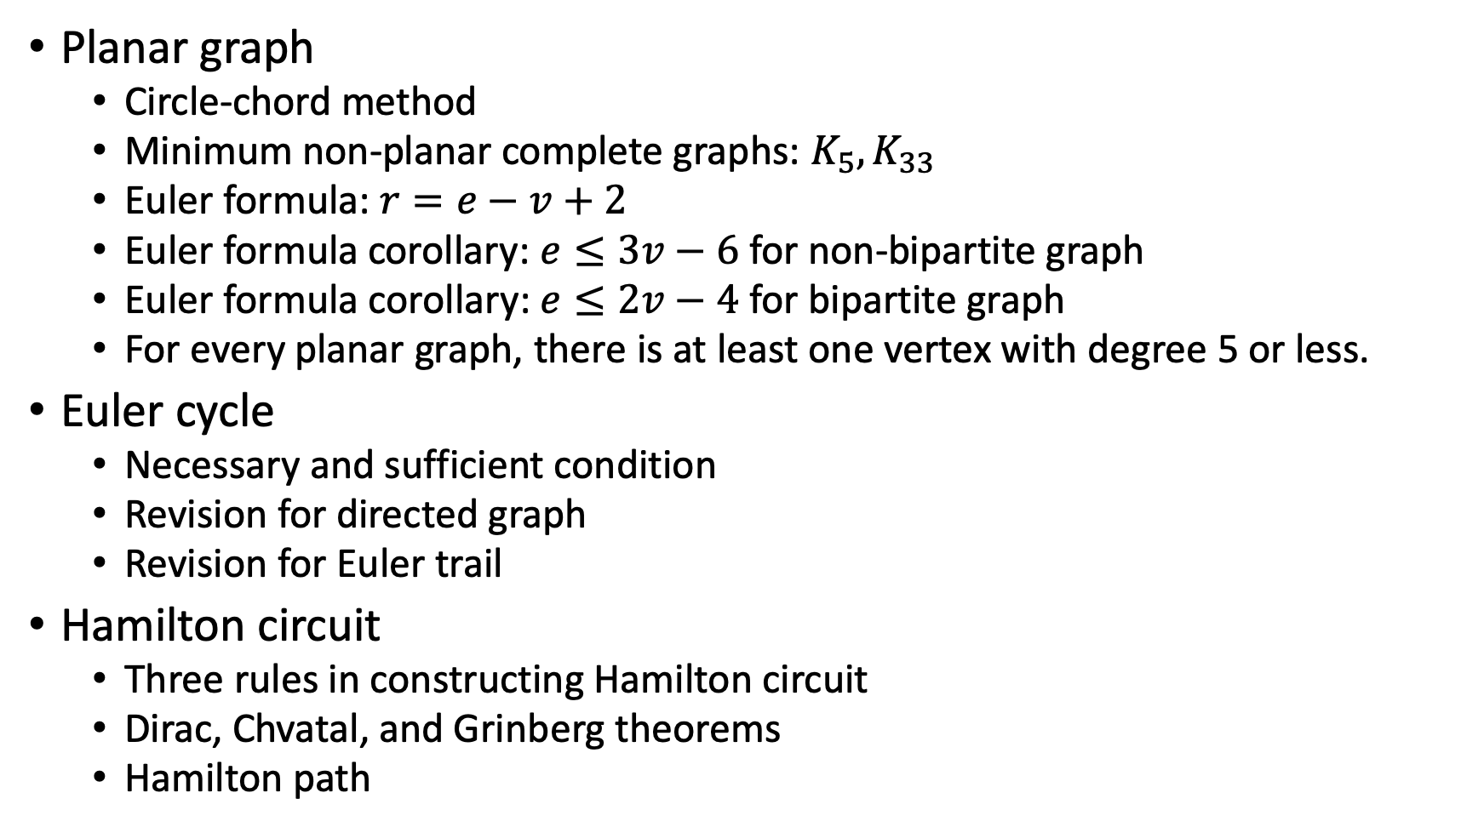
Planar graph
Circle-chord method
Minimum non-planar complete graphs: $K_{5}, K_{33}$
Euler formula: $r=e−v+2$
Euler formula corollary: $e≤3v−6$ for non-bipartite graph
Euler formula corollary: $e≤2v−4$ for bipartite graph
For every planar graph, there is at least one vertex with degree 5 or less.
Euler cycle
Necessary and sufficient condition
Revision for directed graph
Revision for Euler trail
Hamilton circuit
Three rules in constructing Hamilton circuit
Dirac, Chvatal, and Grinberg theorems
Hamilton path

Slide 3
Graph coloring
Walking method, chromatic number
Chromatic number for circuit and wheel
Chromatic number for complete, bipartite graphs
Chromatic number for triangulated polygon
Chromatic number for tree
Independent set
Application: scheduling and surveillance
Chromatic polynomial
Deleting and coalescing (merging) method
Coloring planar graph
Six color conjecture proof
Five color conjecture proof

Slide 4
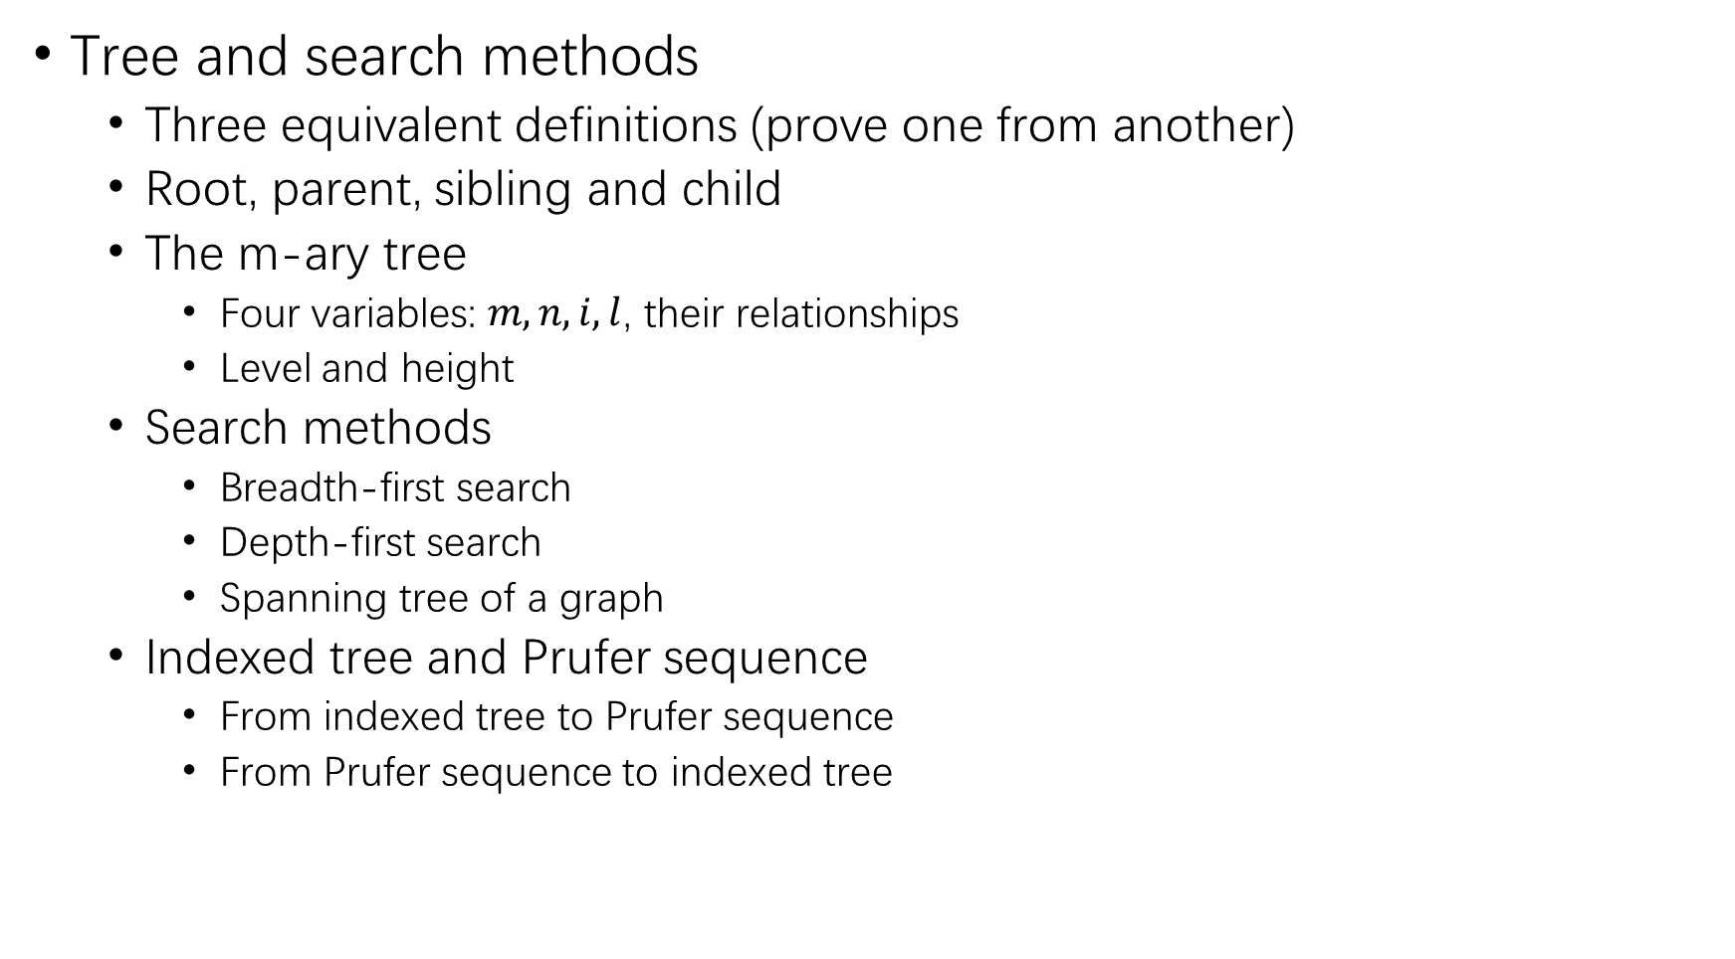
Tree and search methods
Three equivalent definitions (prove one from another)
Root, parent, sibling and child
The m-ary tree
Four variables: $m, n, i, l$, their relationships
Level and height
Search methods
Breadth-first search
Depth-first search
Spanning tree of a graph
Indexed tree and Prufer sequence
From indexed tree to Prufer sequence
From Prufer sequence to indexed tree

Slide 5
Network problem (weighted graph)
Dijkstra algorithm for shortest paths
Distance table, initiation and update
Order of visiting unvisited vertices
Minimum (or maximum) spanning tree
Kruskal’s algorithm

